Slide 1
Transitions ~ A Journey
This Poiesis is a response to the voices in
our community.
Sally Gray and Vicki Mckenzie 2022

Slide 2
(Aho, n.d.)
Notes:
Vicki, I love this- clever you! So beautiful.

Slide 3
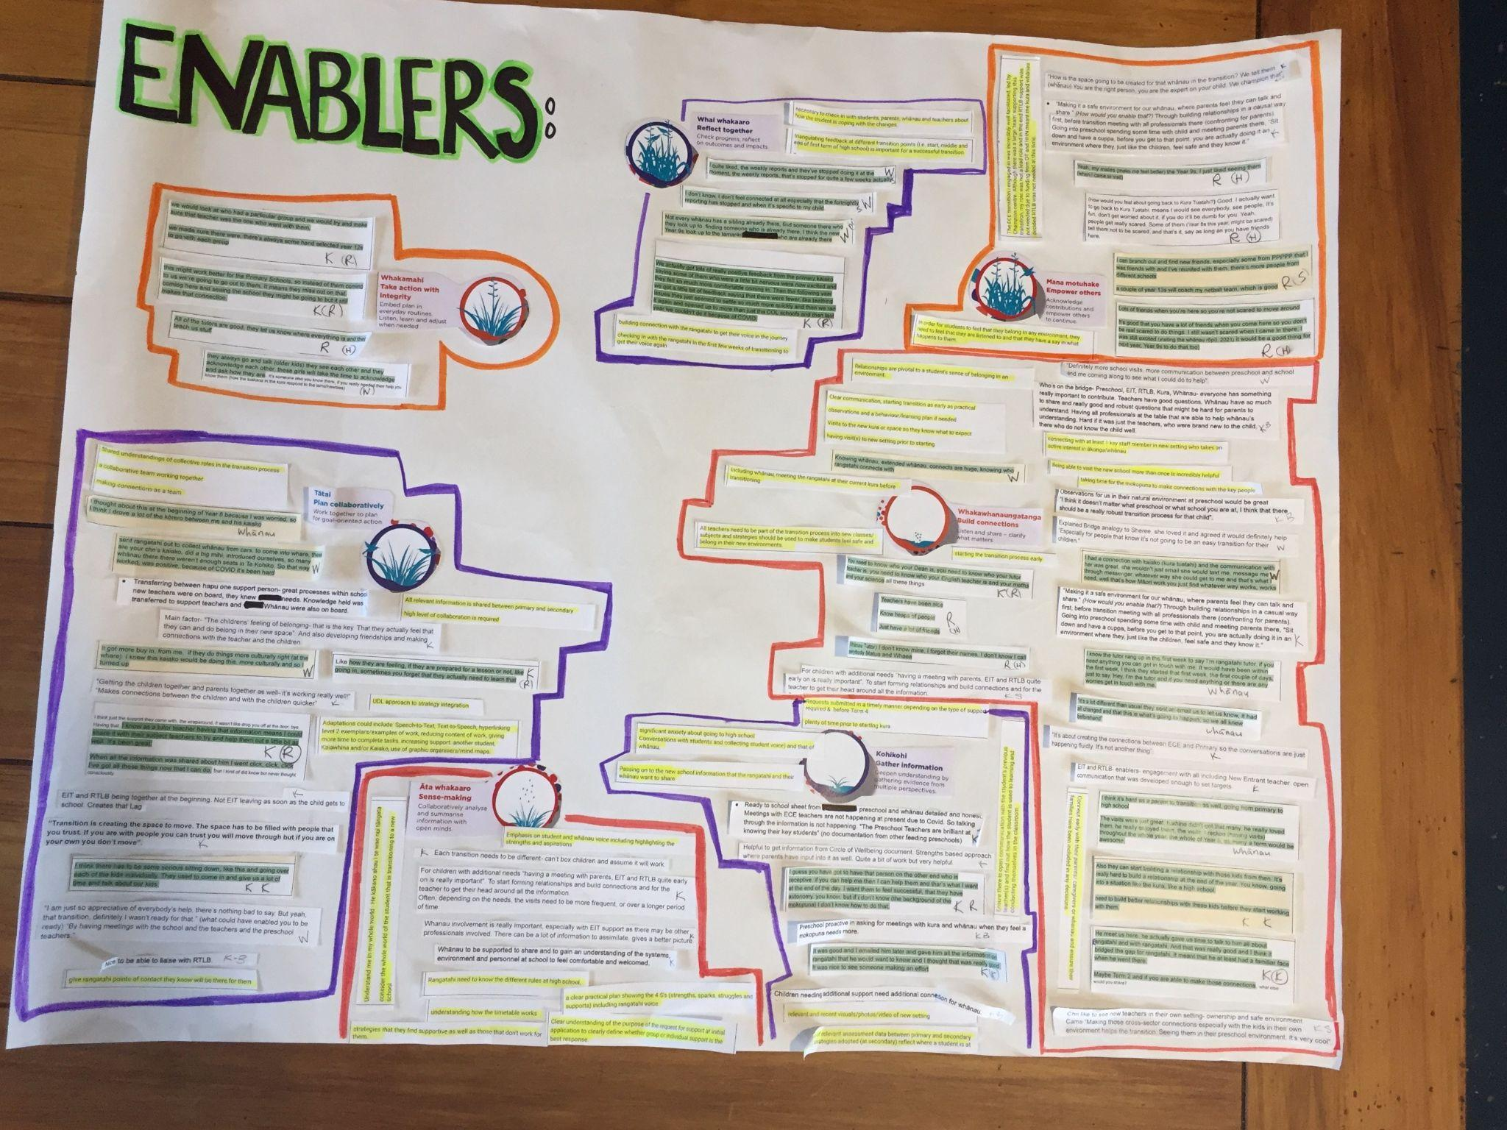
We were guided by the voices gathered from Whānau, Rangatahi, Primary and Secondary Kaiako, ECE & RTLB.
From these Voices we identified the Enablers to Support Successful Transitions.

Slide 4
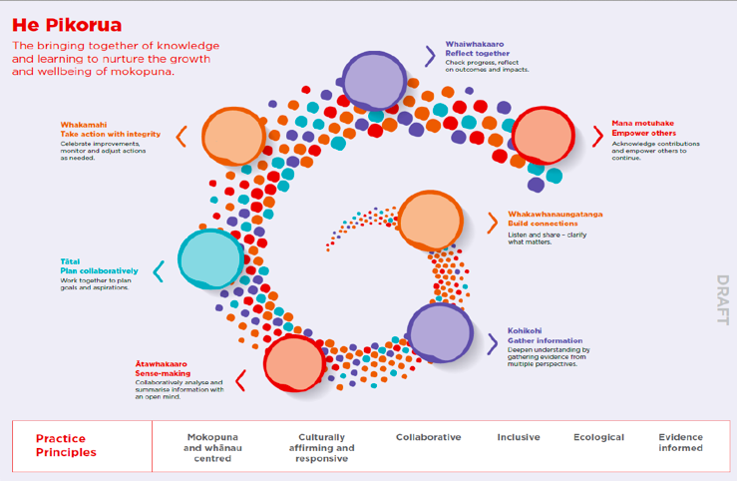
Notes:
Vicki, I love this- clever you! So beautiful.

Slide 5
Providing time to develop relationships is critical to seamless transition (TKI Te Kete Ipurangi, 2015)
‘Being able to visit the new school more than once is incredibly helpful. Taking time for the mokopuna to make connections with the key people’. RTLB
‘The visits were just great (his older sibling) didn’t get that many. He really loved them, he really enjoyed them. I reckon having visits throughout the whole of year out would be awesome’. Whānau
Positive Relationships between kaiako and mokopuna are directly linked to improved wellbeing and engagement with learning, (Cunning ham, 2020)across all settings (Hawk et al. 2002)
‘Children needing additional support need additional connection for whānau’. Kaiako
‘The children’s sense of belonging- that is the key. That they actually feel that they can and do belong in their new space. Developing friendships and making connections with the teacher and the children’. Kaiako
Nurturing and supportive interactions and relationships provide a better environment for development (The Psychology Notes Headquarters, 2019).
‘Knowing whānau and extended whānau connects are huge, knowing who rangatahi connects with’. Whānau
‘Relationships are pivotal to a students sense of belonging in an environment’. RTLB

Slide 6
Ka Hikitia - Ka Hāpaitia (Te Tāhuhu o Te Mātauranga Ministry of Education, 2022b) supports mokopuna and whānau to be at the centre of any planning and decision making during the transition process and beyond.
‘Who’s on the bridge - Pre-school, EIT, Kura, Whānau - everyone has something really important to contribute. Teacher’s have good questions, whānau have so much to share and really good robust questions. Having all professionals at the table, who are able to help whānau understanding’. Kaiako
‘I had a connection kaiako (at Kura Tuatahi) and the communication with her was great. She wouldn’t just email, she would text me, message me, whatever way she could get to me and that’s what I need. Well that’s how Māori work, you just find whatever way works, works’. Whānau
Mokopuna feel whanaungatanga when there is mutual reciprocity (Manaakitia ā Tātou Tamariki Children’s Commissioner, 2018).
Significant Relationships enable or prevent them from achieving (Manaakitia ā Tātou Tamariki Children’s Commissioner, 2018)
‘I don’t know mine (whānau tutor) I forgot their names, I don’t know, I call everybody Matua and Whaea’. Rangatahi

Slide 7
When we identify and consider our students’ Funds of Knowledge we can use our understanding to, connect with and build relationships, determine what and how they learn best and identify tools they can use to access skills and content(Stoler, 2020).
‘Strengths based approach, where parents have input in to it as well. Quite a bit of work, but very helpful’. ECE Kaiako
A strong sense of belonging determines whether mokopuna are motivated and able to actively engage with their environment (Nowicki, 2008)
‘Making cross-sector connections especially with the kids in their own environment. It’s very cool’. ECE Kaiako
Do mokopuna and whānau see themselves within the kura? (CORE Education, 2017)
‘Child is at the centre and the parents wrap around the child. You can’t get to the child unless you go through the parents and I think that is one of the things that can be missing’. Kaiako
Feeling connected to others has a direct correlation with successful outcomes mokopuna experience (Cunningham, 2020).
‘Making a safe environment for our whānau where parents feel they can talk and share. Through building relationships, before the transition meeting with all the professionals there, that’s confronting for parents’. Kaiako

Slide 8
A call to action…
Whakawhanaungatanga
How can we establish our team of mokopuna, kaiako and kaimahi, which enables concerns and worries to be shared, including possible enablers and barriers to change?
What and who is important to mokopuna, whānau and kaiako? (pace, place, people, protocols/tikanga).
How will we all build trust in the team, developing a clear purpose and respecting unique contexts that are mana enhancing?
(Ministry of Education Te Tāhuhu o Te Mātauranga, n.d.)
Te Arotahi (Tailored)

Slide 9
This supports a strengths based approach towards transition, inclusive of Māori learners and their whānau (Te Tāhuhu o Te Mātauranga Ministry of Education, 2022b) and Pacific families (Inclusive Education, n.d.) to create educational opportunities that respond to shared hopes and dreams (Te Tāhuhu o Te Mātauranga Ministry of Education, 2022).
‘A strengths based approach where parents have input into it as well. Quite a lot of work but very helpful’ Kaiako
‘I gave him (Primary School Kaiako), all the information on rangatahi that he would want to know and I thought that was really good. It was nice to see someone making an effort’ Kaiako.
“Teachers listening to students, get to know them and learn what is important to them. Include learning about their strengths, interests and learning needs to use these as the foundation for an engaging learning programme.” RTLB
‘They are all so different- our kids, and without those robust transition processes you just really don’t know where to place them when they start school’. Kaiako

Slide 10
A call to action…
Kohi kohi
As a team, consider how we can begin by gathering information within the everyday conversations, activities, and routines of mokopuna?
What information needs to be gathered? How does this align with the goals and intended outcomes for mokopuna, whānau and kaiako?
What culturally aligned frameworks and tools will we use to gather information?
(Ministry of Education Te Tāhuhu o Te Mātauranga, n.d.)
Te Arotahi (Tailored)

Slide 11
In ERO (2015) whānau voice identified, the best thing that happened for her child was everyone sitting down and making a plan together
‘For children with additional needs having a meeting with parents, EIT & RTLB quite early on is really important. Often depending on the needs, the visits need to be more frequent or over a longer period of time’ Kaiako
‘Being able to make connections and share data prior to ākonga returning is extremely important’ RTLB
‘Definitely more school visits, more communication between preschool and school, and me coming along to see what I could do to help’. Whānau

Slide 12
A call to action…
Āta whakaaro
How are we taking the time to make sense of the information gathered?
How do we incorporate differing worldviews, which might result in different interpretations, into a shared āta whakaaro?
How does āta whakaaro help us to be responsive to the goals and aspirations that mokopuna, whānau and kaiako have identified?
(Ministry of Education Te Tāhuhu o Te Mātauranga, n.d.)
Te Arotahi (Tailored)

Slide 13
Tuna are not all the same, many different techniques are needed to ‘catch’ them, utilising many strategies from a variety of sources (Evaluation Associates Ltd, 2019).
‘I think there has to be some serious sitting down and going over each of the kids individually’. Kaiako
Hawk and Hill (2004) recognise that liaising prior to transition between both school communities, is conducive to a successful transition, alongside having systems and strategies in place.
‘Kaiako sent rangatahi out to collect whānau from cars, to come into where, these are your children’s kaiako, did a big mihi, introduced ourselves, so many whānau there, there weren’t enough seats. So that worked, was positive, because of Covid it’s been hard’. Whānau
Communication and connection within the transition team is essential when supporting priority learners, providing ongoing support throughout the entire first year, if need be (Cunningham, 2020)
‘ I thought about this at the beginning of year 8 because I was so worried, so I think I drove a lot of the kōrero between me and his kaiako’. Whānau

Slide 14
A call to action…
Tātai
How are mokopuna, whānau and kaiako central to the collaborative planning process?
How are we selecting approaches, tools and strategies that will have the most impact on progress towards the goals?
How are we ensuring ideas and strategies in the plan can be integrated into the everyday interactions, activities, and routines of mokopuna?
(Ministry of Education Te Tāhuhu o Te Mātauranga, n.d.)
Te Arotahi (Tailored)

Slide 15
Culturally affirming practices are key to developing mana enhancing relationships with Māori and Pacific learners (Hawk et al. 2002).
‘Teachers listening to students, get to know them and learn what is important to them. Include learning about their strengths, interests and learning needs to use these as the foundation for an engaging learning programme.’RTLB
‘They (the older rangatahi) always go and talk, they see each others, they acknowledge each other. These girls will always take the time to acknowledge and ask how they (Year 9 rangatahi) are’. (Tuakana/Teina) Whānau

Slide 16
A call to action…
Whakamahi
What monitoring processes are in place to ensure the plan will be implemented authentically, as agreed by all?
How is the whole team shared with and involved in the ongoing monitoring and review process? (including the important roles of mokopuna, whānau and kaiako).
(Ministry of Education Te Tāhuhu o Te Mātauranga, n.d.)
Te Arotahi (Tailored)

Slide 17
Mokopuna share that the three most important aspects that support transition are the kaiako, the welcoming and peer support (Manaakitia ā Tātou Tamariki Children’s Commissioner, 2018).
‘Transition is creating the space to move. The space has to be filled with people that you trust. If you are with people you trust you will move through but if you are on your own you don’t move’. ECE Kaiako
‘Building connection with the rangatahi to get their voice in the journey and checking in with the rangatahi in the first few weeks of transition to get their voice again.’ RTLB
‘Necessary to check in with students, parents whānau and teachers about how the student is coping with the changes’. RTLB
‘Relationships are pivotal to a students sense of belonging in an environment’. RTLB

Slide 18
A call to action…
Whai Whakaaro
Consider with mokopuna, whānau and kaiako, how well have we incorporated their perspectives when making decisions and moving toward mana motuhake?
What opportunities and barriers did we encounter along the way and what has changed as a result of our teamwork?
How well have we gathered and shared evidence and outcomes data to illustrate change and progress?
(Ministry of Education Te Tāhuhu o Te Mātauranga, n.d.)
Te Arotahi (Tailored)

Slide 19
It’s important that whānau are able to be in a space where they feel comfortable, accepted, learning from each other and sharing each other's experiences without judgement (531pi, 2021a).
‘Making a safe environment for our whānau, where parents feel they can talk & share’ Kaiako
‘We tell them (whānau)- You are the right person, you are the expert on your child. We champion that’. ECE Kaiako
‘A Parent involved and informed in the transition will work harder (to make it successful for their mokopuna)’. ECE Kaiako
Mokopuna bring with them, their past, present and future - who they are and where they are from as Brigham Riwai-Couch so beautifully expresses this with his analogy comparing Māori rangatahi to tuna (Evaluation Associates Ltd, 2019).
‘Having conversations with students and collecting student voice, and that of whānau’. RTLB
‘Whānau involvement is really important’. Kaiako
The Action Plan for Pacific Education (Te Tāhuhu o Te Mātauranga Ministry of Education, 2022) affirms that partnering with families provides the opportunity to hear family aspirations leading to academic achievement (Cunningham, 2020).
‘Child is at the centre and the parents wrap around the child. You can’t get to the child unless you go through the parents and I think that is one of the things that can be missing’. Kaiako

Slide 20
Being accepted and sharing experiences provides an opportunity to know what is in the kete mokopuna will bring to kura as Funds of Knowledge Luis et al. (1992)
‘Making a safe environment for our whānau, where parents feel they can talk & share’ Kaiako
‘We tell them (whānau)- You are the right person, you are the expert on your child. We champion that’. ECE Kaiako
Te Tāhuhu o Te Mātauranga Ministry of Education (2022b) Ka Hikitia - Ka Hāpaitia states that productive partnerships support strong relationships between learners and whānau, hapū, iwi, educators and others to support excellent outcomes.
“Teachers listening to students, get to know them and learn what is important to them. Include learning about their strengths, interests and learning needs to use these as the foundation for an engaging learning programme.” RTLB
When whānau and educators are seen as equal partners mokopuna are more likely to transition successfully (ERO, 2015)
Being able to live our values, seeing themselves in the new environment (CORE Education, 2017) are important to reflect on when considering what belonging looks and feels like for mokopuna and whānau.
‘The children’s sense of belonging- that is the key. That they actually feel that they can and do belong in their new space. Developing friendships and making connections with the teacher and the children’ Kaiako

Slide 21
A call to action…
Mana Motuhake
How well have we acknowledged the team’s contributions, encouraged empowerment and celebrated the successes?
How confident are we that progress will be sustained? What else might be needed?
Connect with mokopuna, whānau and kaiako about the process and to inform the future.
(Ministry of Education Te Tāhuhu o Te Mātauranga, n.d.)
Te Arotahi (Tailored)

Slide 22
This Poiesis has been created in response to our voices to guide future transition practice by…
- strengthening how we collaborate with whānau and kaimahi
- being culturally responsive and reflective to Te Tiriti o Waitangi
- holding mokopuna at the centre, enabling them to flourish
during and beyond.

Slide 23
References
531pi. (2021a, January 11). Talanoa Ako Week 2 “New Experiences” with Karl Vasau & Natalie Faitala. Live on #531pi Breakfast for more info https://parents.education.govt.nz/. . ./talanoa-ako-radio. . ./ [Facebook]. Facebook. https://www.facebook.com/page/107643629279334/search/?q=talanoa%20ako%20
Aho. (n.d.). Manu + Whakataukī Wall Decal Set [Illustration]. Aho. https://ahocreative.com/collections/aho-iti
CORE Education. (2017, February 21). Seeing your school through the eyes of Māori parents [Video]. Vimeo. https://vimeo.com/205147189
Cunningham, E. (2020, June 2 ). The Transition to Secondary School. The Education Hub. https://theeducationhub.org.nz/the-transition-to-secondary-school/
Education Review Office. (2015, June 19). Continuity of learning transitions from early childhood services to schools. New Zealand Government. https://ero.govt.nz/our-research/continuity-of-learning-transitions-from-early-childhood-services-to-schools
Evaluation Associates Ltd. (2019, March 18). “10 ways to teach me” – Brigham Riwai-Couch [Video]. Vimeo. https://vimeo.com/325105212
Hawk, K., & Hill, J. (2004, April 18). Transition traumas, traps, turning points and triumphs: Putting student needs first. The Education Group. http://educationgroup.co.nz/resources/education-group-resources/
Let’s Learn Māori. (2016, May 11). The tūī chatters, the kākā cackles and the kererū coos [Facebook Post]. Facebook. https://www.facebook.com/letslearnmaori/photos/e-koekoe-te-t%C5%AB%C4%AB-e-ketekete-te-k%C4%81k%C4%81-e-k%C5%ABk%C5%AB-te-kerer%C5%AB-the-t%C5%AB%C4%AB-chatters-the-k%C4%81k%C4%81-ca/684875831653913/
Luis C. Moll , Cathy Amanti , Deborah Neff & Norma Gonzalez (1992) Funds of knowledge for teaching: Using a qualitative approach to connect homes and classrooms, Theory Into Practice, 31:2, 132-141, DOI: 10.1080/00405849209543534

Slide 24
References
Manaakitia ā Tātou Tamariki Children’s Commissioner. (2018, March 14). Education matters to me: Transitions. The Office of the Children’s Commissioner. https://www.childrenandyoungpeople.org.nz/publications/reports/education-matters-to-me-transitions/
Ministry of Education Te Tāhuhu o Te Mātauranga. (n.d.). He Pikorua in action Reflective questions. He Pikorua. https://hepikorua-prod-storagestack-assetstorages3bucket-1dupxbef0nyh2.s3.ap-southeast-2.amazonaws.com/public/updates/He-Pikorua-Table-Talker-for-print-April-2022.pdf
Nowicki. A. (2008). Self-efficacy, sense of belonging and social support as predictors of resilience in adolescents. [Honours Thesis] Edith Cowan University. https://ro.ecu.edu.au/cgi/viewcontent.cgi?article=2154&context=theses_hons
Stoler, S. (2020, August 19). Funds of Knowledge Overview [Video]. YouTube. https://www.youtube.com/watch?v=K7_9Lc93kcQ
Te Tāhuhu o Te Mātauranga Ministry of Education. (2022). Action Plan for Pacific Education 2020–2030. Ministry of Education. https://www.education.govt.nz/our-work/overall-strategies-and-policies/action-plan-for-pacific-education-2020-2030/
Te Tāhuhu o Te Mātauranga Ministry of Education. (2022b). Ka Hikitia – Ka Hāpaitia | The Māori Education Strategy. Ministry of Education. https://www.education.govt.nz/our-work/overall-strategies-and-policies/ka-hikitia-ka-hapaitia/ka-hikitia-ka-hapaitia-the-maori-education-strategy/
The Psychology Notes Headquarters. (2019, May 3). What is Bronfenbrenner’s Ecological Systems Theory? https://www.psychologynoteshq.com/bronfenbrenner-ecological-theory/
TKI Te Kete Ipurangi. (2015, October 12). The Katote cluster – working together. Ministry of Education Te Tāhuhu o Te Mātauranga. https://elearning.tki.org.nz/Leadership/Communities-of-Learning/The-Katote-cluster-working-together
Moorfield, J. (2011). Te Aka Māori-English, English-Māori Dictionary (3rd ed.). Longman/Pearson Education New Zealand.

Slide 25
Guide to transitions within our rōhē
What other voice do we need eg LSC? Mana Ake? Wider range of voice?
Create a clear, consistent pathway on how we support the transition process for our priority learners (or mokopuna needing Te Arotahi support)
What part to our LSC colleagues play insupporting transitions
Kāhui ako
How can we ensure that this mahi
the team can use the knowledge, skills, tools, and strategies that have been developed to inform and strengthen future responses?

Slide 26
Provide an enduring resource
He Pikorua is designed for continuous improvement. It aims to be a living resource that is fresh, current and useful:
informed and shaped by ongoing learning
reflecting the knowledge, lived experiences, cultures and practice of all our practitioners, educators and whānau.
We will update and refresh core content, resources, links and examples as required. provide clear, consistent, practical guidance
enable mokopuna to flourish
support our competencies, standards, and codes
strengthen how we work together
build on our strengths
provide an enduring resource

Slide 27
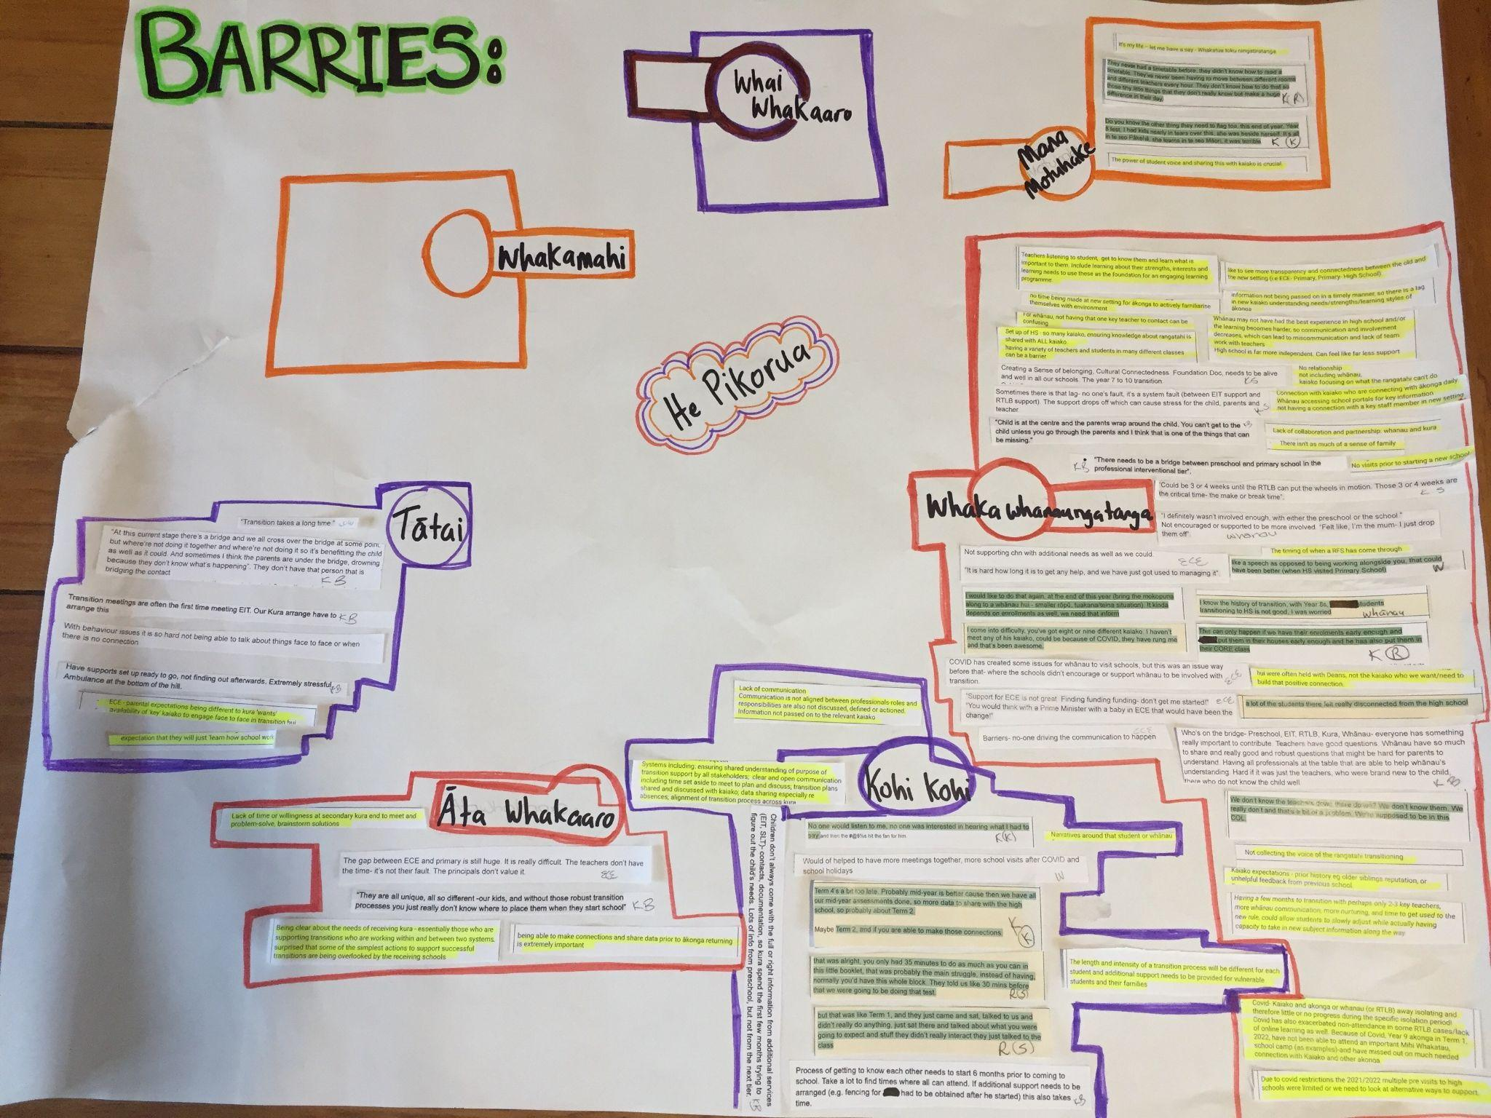
Barriers

Slide 28
Litttek (2021) states that transitions are a process, one of which is recurring throughout the educational journey of mokopuna. Conrad (2010) reiterates that transition is ongoing, not a single point in time (Rosenkoetter et al., 2007). Putting mokopuna at the centre requires kura and kaiako to take the time to plan early for smooth transitions, to build the bridge of connection between both settings (Hawk & Hill, 2004). There are many ways to begin the transition process such as sharing a video about the kura showing a normal day, reciprocal visits of mokopuna and kaiako and connecting with whānau (Hawk & Hill, 2004). Karl Vasau and Natalie Faitala (531pi, 2021c) talanoa about the transition process. They discuss sharing what is involved with transition from ECE, Primary, High School and beyond, and the importance of having early, open honest talanoa with their children. Strong learning partnerships with parents and whānau supported children as they approached and transitioned to school were realised by ERO’s (2015) report as precursors to smooth transitions. These strategies support the communication and connection between the two places that mokopuna are transitioning from and to. Developing relationships between mokopuna, whānau and kaiako. He waka eke noa!

Slide 29
He waka eke noa!
Putting mokopuna at the centre requires kura and kaiako to take the time to plan early for smooth transitions, to build the bridge of connection between both settings (Hawk & Hill, 2004).
Karl Vasau and Natalie Faitala (531pi, 2021c) talanoa about the transition process. They discuss sharing what is involved with transition from ECE, Primary, High School and beyond, and the importance of having early, open honest talanoa with their children.
There are many ways to begin the transition process such as sharing a video about the kura showing a normal day, reciprocal visits of mokopuna and kaiako and connecting with whānau (Hawk & Hill, 2004).
Littek (2021) states that transitions are a process, one of which is recurring throughout the educational journey of mokopuna. Conrad (2010) reiterates that transition is ongoing, not a single point in time (Rosenkoetter et al., 2007).
Strong learning partnerships with parents and whānau supported children as they approached and transitioned to school were realised by ERO’s (2015) report as precursors to smooth transitions. These strategies support the communication and connection between the two places that mokopuna are transitioning from and to. Developing relationships between mokopuna, whānau and kaiako.

